Slide 1
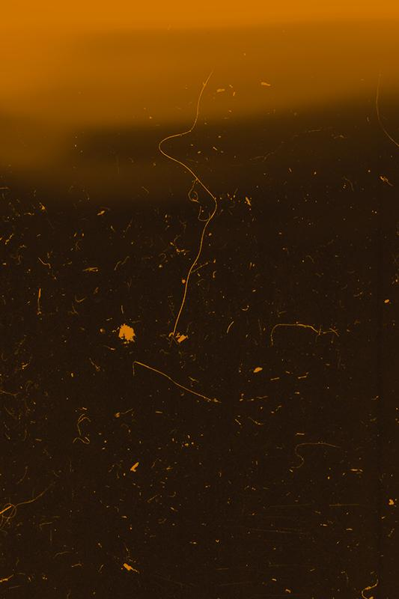

Exoplanet Classification
Osiris
2003
55 Kepler-186f e
2015
Bradley Reardon, Pranay Bhakthula, Baldur Hua, Jichong Wu, Qinyuan Xing

Slide 2
TABLE OF CONTENTS
01.
02.
03.
04.
Dataset Overview
Exploratory Data Analysis & Preprocessing
Multi-logistic Regression
K-Nearest Neighbor
05.
Random Forest
06.
Conclusion

Slide 3
01.
Dataset Overview

Slide 4
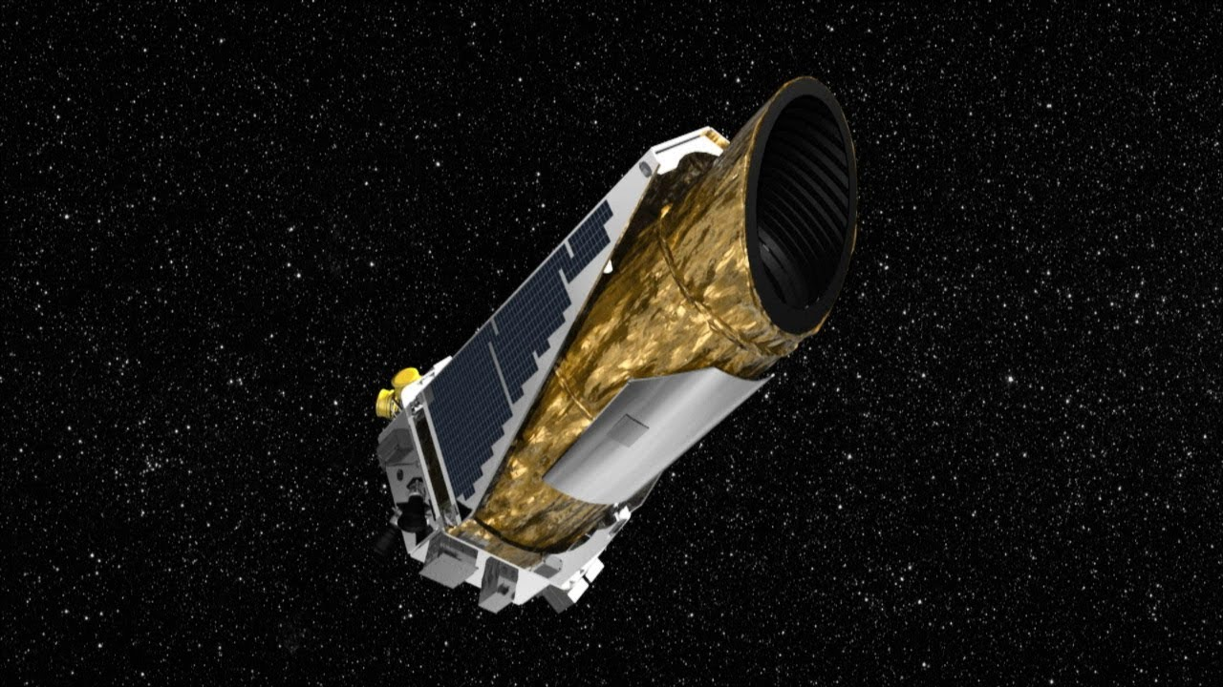
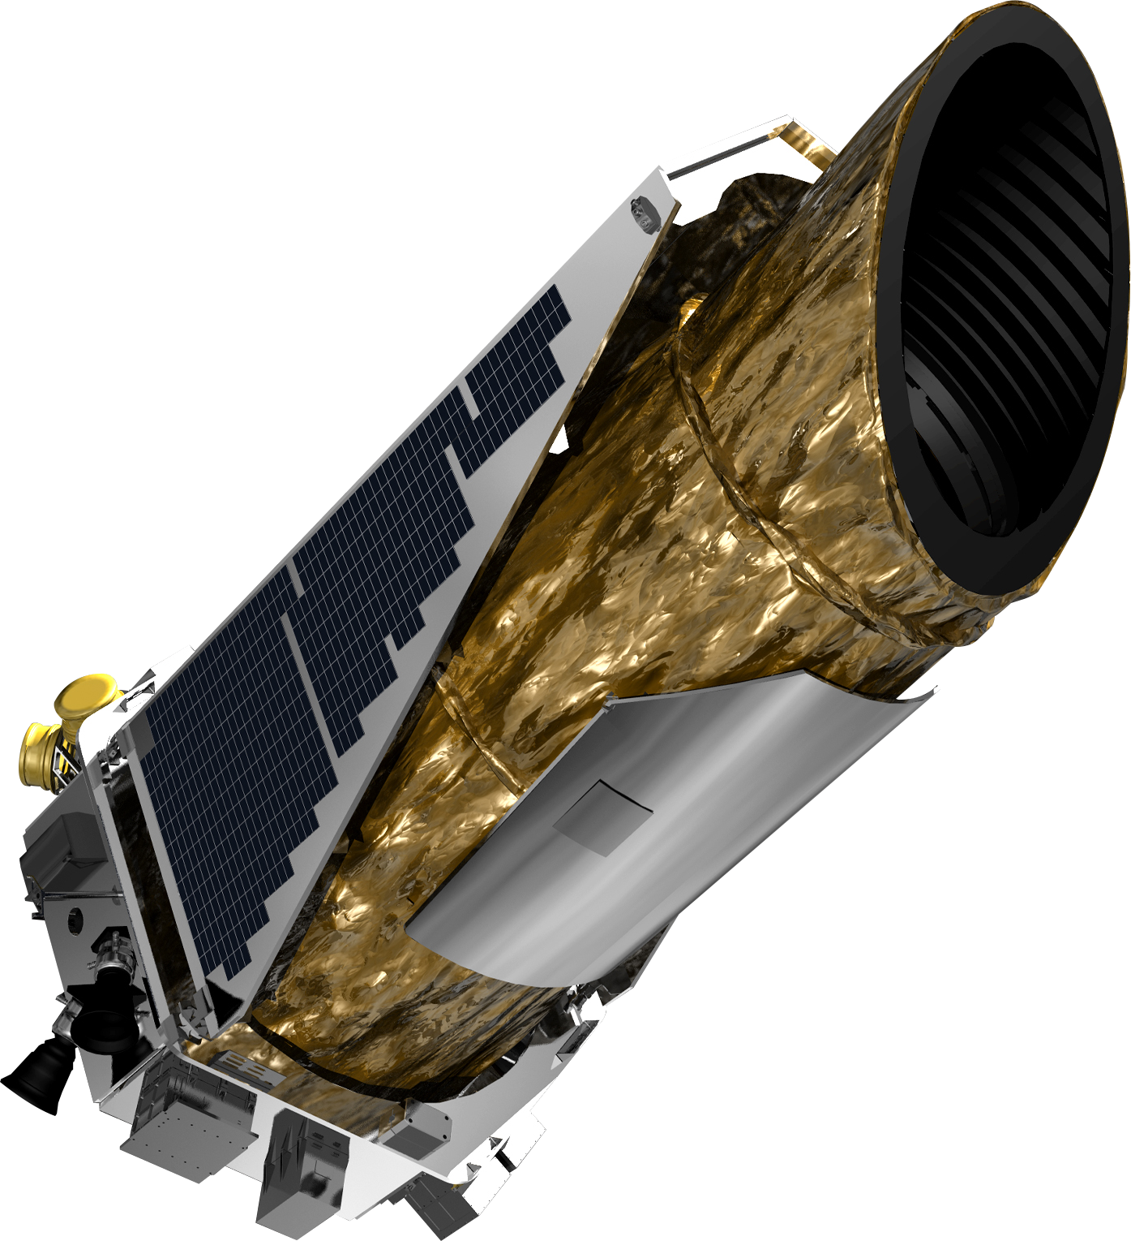
Kepler Space Telescope
Notes:
Have you ever wondered what life on other planets might be like? If so, you are not alone. Humans have been looking to the sky and beyond for centuries wondering what might be found in the vast landscape of the universe. As technology advances, we continue developing tools that allow us to better identify objects of interest beyond the scope of our galaxy, one of those tools being the Kepler Space Telescope (KST). The KST is a space telescope that was launched into Earth’s orbit on March 7, 2009 to monitor more than 150,000 stars in search for transiting exoplanets. All objects the KST shows interest in are labeled as Kepler Objects of Interest

Slide 5
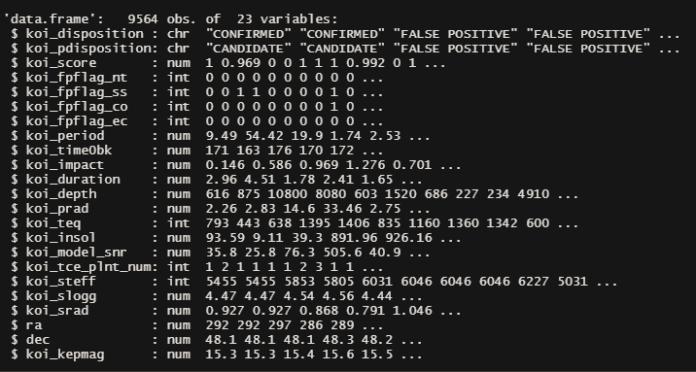
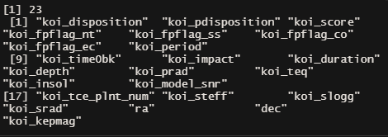
Dataset Overview
Compiled by NASA and the Kepler Space Program
9,565 observations
One observation per Kepler Object of Interest (KOI)
50 features describing the KOIs
23 after dropping unnecessary features
Notes:
the KOI feature data is logged and stored by NASA. This data is available to the public

Slide 6
02.
Exploratory Data Analysis & Preprocessing

Slide 7
EDA & Preprocessing Overview
Target feature
Balance Check
Count Plots
Feature Selection
Stepwise
Regression Subset
Pair plots
Normality check
QQ-Plots
Train-Test Split

Slide 8
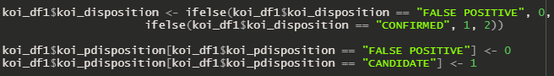
Target Feature
Target feature:
koi_disposition
Three classes:
False positive = 0
Confirmed = 1
Candidate = 2

Slide 9
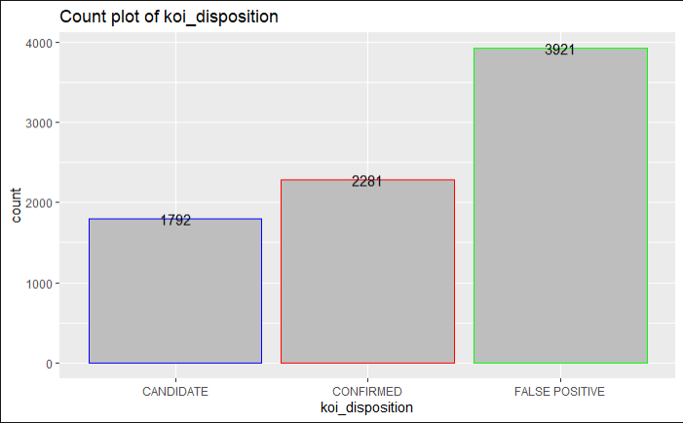
Balance Check
Target feature classes are slightly skewed
False positive class has roughly double the count of Candidate or Confirmed
This can lead to a model being better at classifying False Positives than the other classes

Slide 10
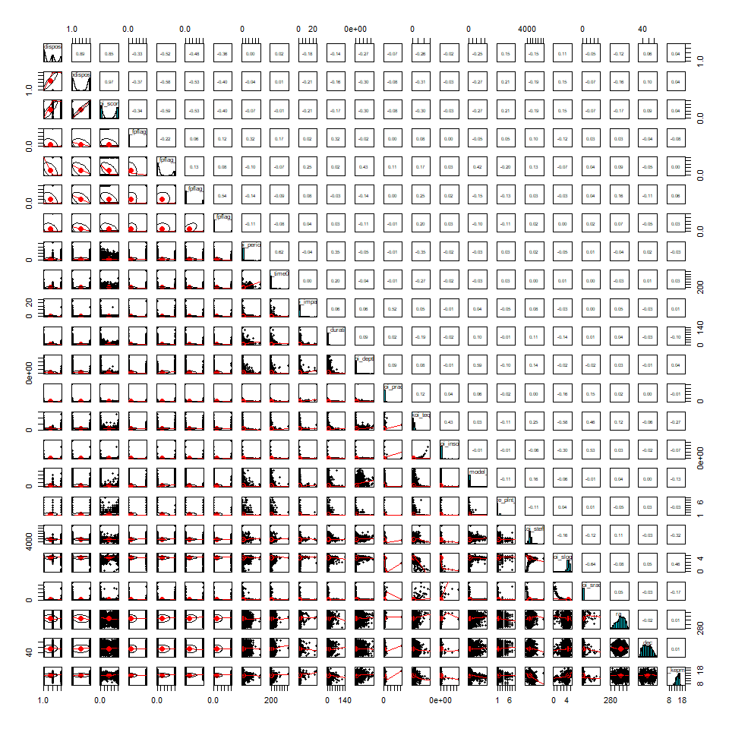
Pairs Plot

Slide 11
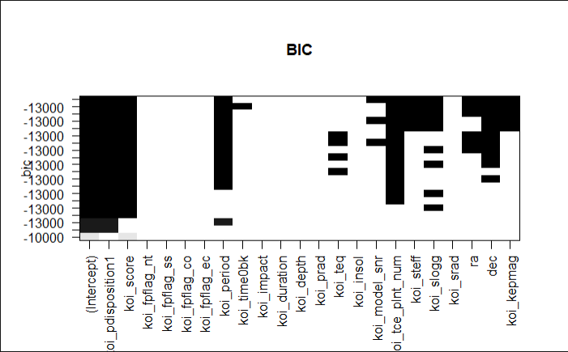
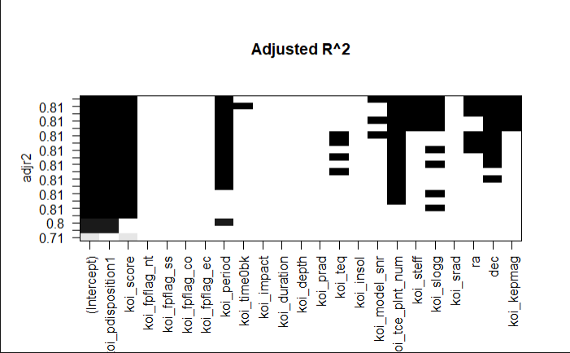

Feature Selection
BIC:
11 features is most efficient
Adjusted R^2:
11 features is most efficient
CP:
11 features is most efficient

Slide 12
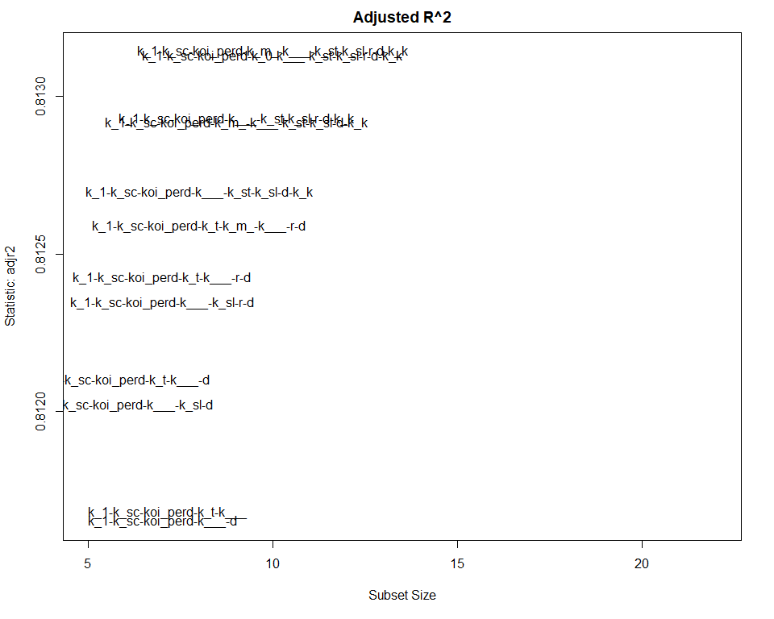
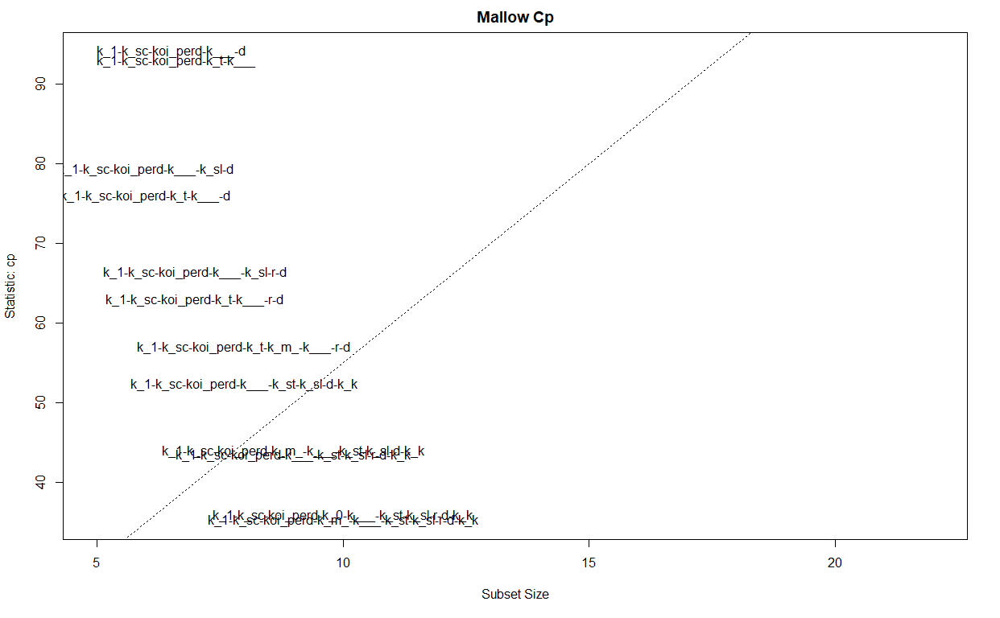
Feature Selection

Slide 13
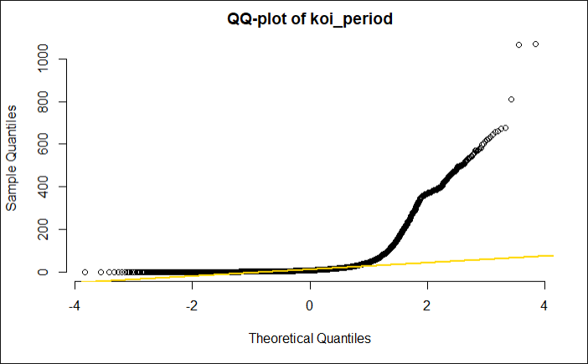
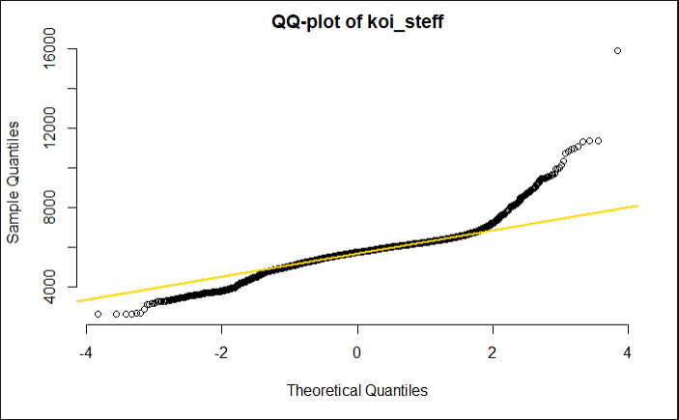
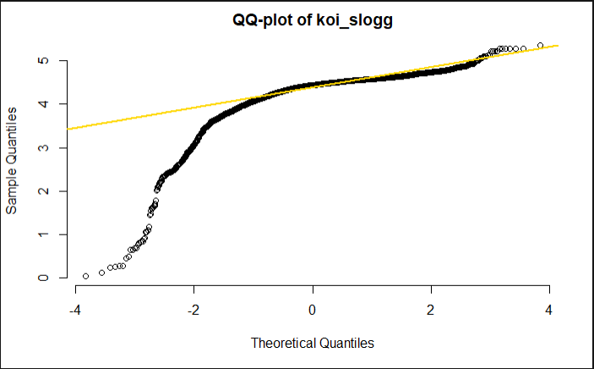
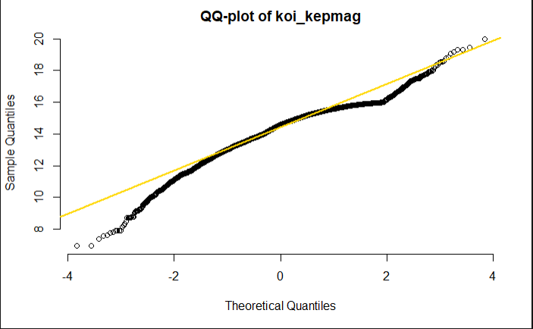
Normality Check
Checked normality of numerical features chosen post-feature selection
Koi_period, koi_steff, koi_slog do not have a normal distribution
Koi_kepmag has a near normal distribution

Slide 14
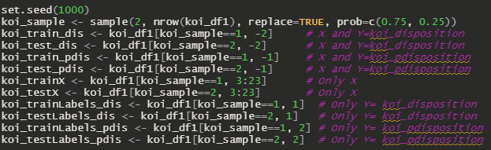
Train-Test Split
Train : Test = 3 : 1
Separate the independent variables and the dependent variable as a whole for the multi-logistic regression
Separate the independent variables and the dependent variable as a whole for the multi-logistic regression

Slide 15
03.
Multi-logistic Regression

Slide 16
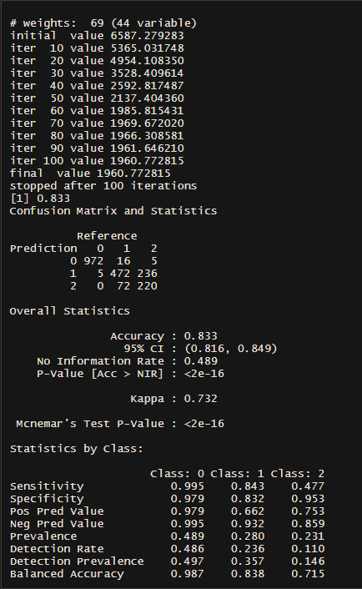
Multi-Logistic Regression
The Accuracy of the Multi-logistic regression is 0.833

Slide 17
04.
K-Nearest Neighbor

Slide 18
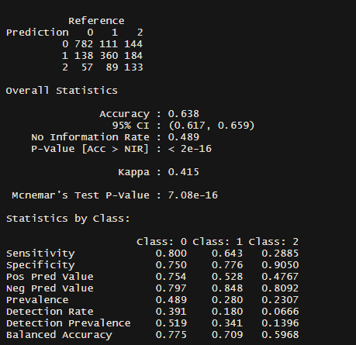
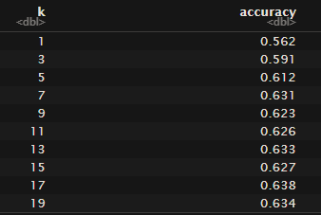
K-Nearest Neighbor
The accuracy of the K-nearest Neighbor is 0.638

Slide 19
05.
Random Forest

Slide 20
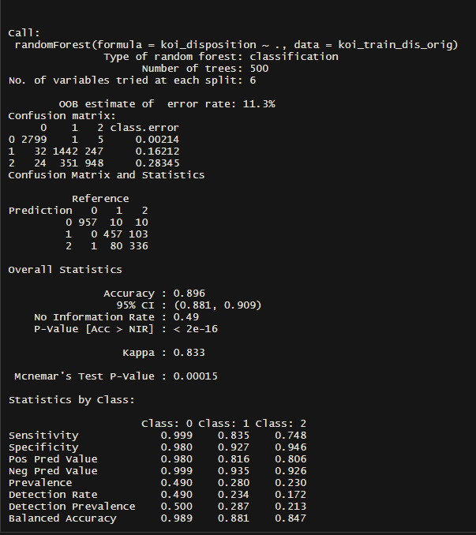
Random Forest
The accuracy of the random forest of the original data set is 0.896

Slide 21
06.
Conclusion

Slide 22
Results
Comparing Model Results
Random forest provides the highest accuracy, since it adds additional randomness to the model (trees). It can find the best feature among the subsets.
Logistic is the fastest model to train, which also give relatively high accuracy. However, logistic regression might be influenced by the multicollinearity of the predictors.
The reason for knn performing poorly might be the dimension of our data set is high and the possible overlapping among the groups while knn is calculating the distance.
Koi_disposition is most effected by the following variable: koi_pdisposition, koi_score, koi_period and dec.

Slide 23
Caveats
High number of features
Could not use stepwise feature selection like we wanted to
Pairs-plot is unreadable
More time is required for knn model
Most numerical features we tested for normality did not have a normal distribution

Slide 24
Citations
https://www.nasa.gov/mission_pages/kepler/overview/index.html
https://www.kaggle.com/nasa/kepler-exoplanet-search-results
https://www.nasa.gov/ames/kepler/nasas-kepler-discovers-first-earth-size-planet-in-the-habitable-zone-of-another-star
https://www.nasa.gov/vision/universe/newworlds/Osiris_leaks.html

Slide 25
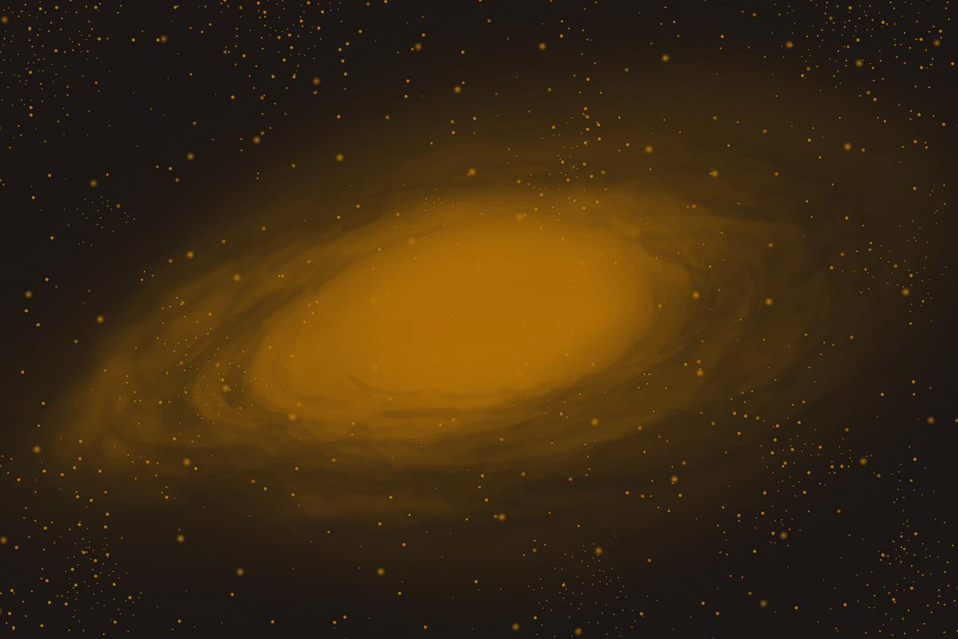
Thank you!

